Slide 1
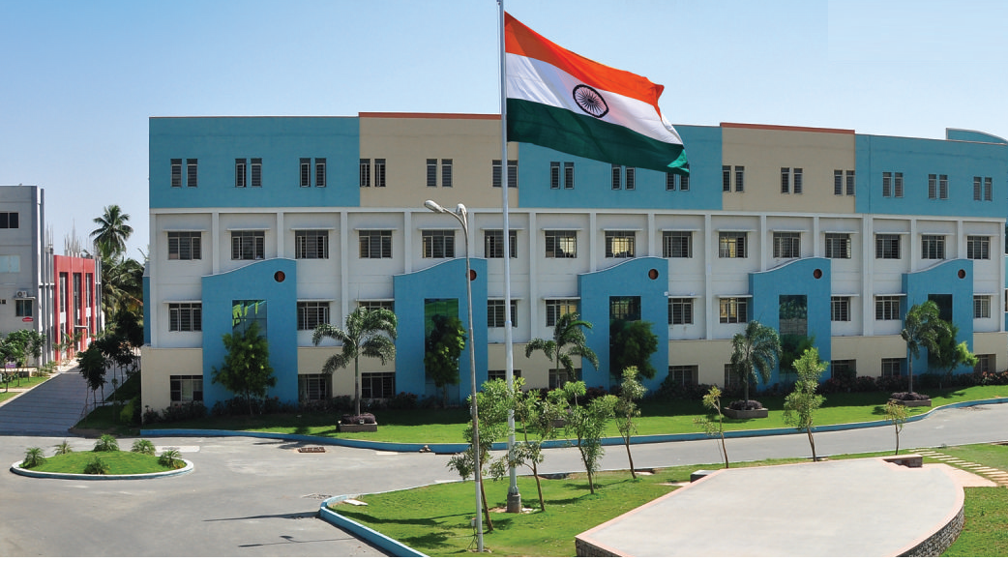
SRI ESHWAR COLLEGE OF ENGINEERING academic year: 2016-17 department: CIVIL
FINAL YEAR PROJECT REVIEW – 1
Date of review:07.07.2017

Slide 2
PLANNING,ANALYSIS AND DESIGN OF MODERN HOSTEL AT SECE
BATCH MEMBERS
1) HARINI V
2) GOWTHAMAN M
3) HARI PRAKASH N
4) MOHAN PRAKASH S
GUIDE NAME
YUVARAJ S
Asst.Prof/CIVIL Dept.

Slide 3
Presentation Outline
Abstract
Need for study
Objective
Methodology
Literature Survey’s

Slide 4
Abstract
A design of RC building of G+4 frame work is taken up
The total area of hostel building is about 103145 sqft (approx. 2acre)
In order to develop an efficient building some chemical compounds are added along with concrete mixture

Slide 5
NEED FOR STUDY
In order to compete in the ever growing competent, it is very important for the structural engineer to create innovations
As a sequel to this an attempt is made to analyse and design a Modern Hostel Building
This hostel building Is a way new idea to be considered
To enable them to experience a zone of comfort with multi facilities.
Multi facilities include Gym, Indoor games, Library, Firstaid Room, Open air dinner hall, Auditorium, Mess hall Etc..,,
Mat foundation is adopted for this project since the area of construction is large and number of column is more.

Slide 6
OBJECTIVES
To plan an Modern hostel with an area as per the requirements of the management needed .
To analyze and design all the structural and non-structural components of the hostel building.
Plan using AUTOCAD
Analysis using STAAD PRO

Slide 7
Methodology
Selection of Title
Literature Study
Plan using AutoCAD
Structural Analysis
Manual Design
Result
Conclusions

Slide 8
LITERATURE SURVEY
Divya kmath, K.Vandana Reddy, Analysis and design of reinforced concrete structures-A G+4 building model, miniproject report, Gokaraju Rangaraju Institute of Engineering and Technology, Hyderabad, India, 2012
Soil and Foundation hand book, State Materials Office Gainesville, Florida, 2004

Slide 9
Literature Survey (Cont’d..)
JOURNAL | CTBUH JOURNAL, 2015 ISSUE 2
TITLE | Advanced structural Technology for High Rise Hotel Building in Japan
AUTHOR(S) | Masayoshi Nakai,
INFERENCE | Building structures primarily need to support gravity weight and seismic members should absorb earthquake energy.

Slide 10
Literature Survey (Cont’d..)
JOURNAL | International Journal of Research in Engineering and Technology eISSN: 2319-1163 | pISSN: 2321-7308
TITLE | DESIGN OF MULTI STOREY HOTEL BUILDING RESTING ON SINGLE COLUMN
AUTHOR(S) | Madireddy Satyanarayana
INFERENCE | Limit state method of design is adopted. The Design Aids of Concrete and detailing is understood.

Slide 11
Literature Survey (Cont’d..)
JOURNAL | International Journal for Scientific Research & Development| Vol. 3, Issue 09, 2015 ISSN : 2321-0613
TITLE | Study of Seismic Analysis between Conventional RC Frame and Flat Slab
AUTHOR(S) | Muniraju K.S, Subramanya K.G
INFERENCE | The behavior of flat slab frame with different heights is inferred. The Conventional R.C frame and flat slab R.C. frame with different height for different combinations of static loading is learnt.

Slide 12
Literature Survey (Cont’d..)
JOURNAL | International Conference on Civil Engineering Research (ICCER), Jan 27 2016
TITLE | Model Swimming Pool Design
AUTHOR(S) | Edwin Lomax
INFERENCE | The Hydraulic Flow of Water within the Swimming Pool Area Should be Precise And the Temperature and water level are to be checked regularly.

Slide 13
Work Schedule
S.No | DATE | WORK TO BE DONE
1. | 07.07.2017 | Selection of topic
2. | 14.07.2017 | Collection of literatures
3. | 20.07.2017 | Planning
4. | 27.07.2017 | Analysing
5. | 05.08.2017 | Designing
6. | 12.08.2017 | Generation of reports
7. | 7.10.2017 | Preparation of books
8. | 20.10.2017 | Submission of book

